Slide 1
Teaching Python to Everyone: AKA: The End of Dilbert
Charles Severance
University of Michigan
School of Information

Slide 2
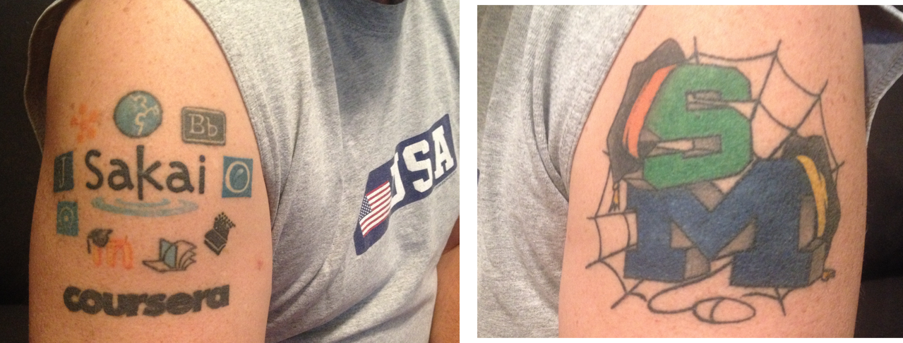

Slide 4
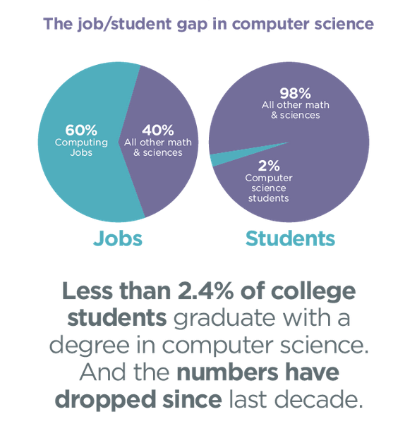
http://code.org/stats

Slide 5
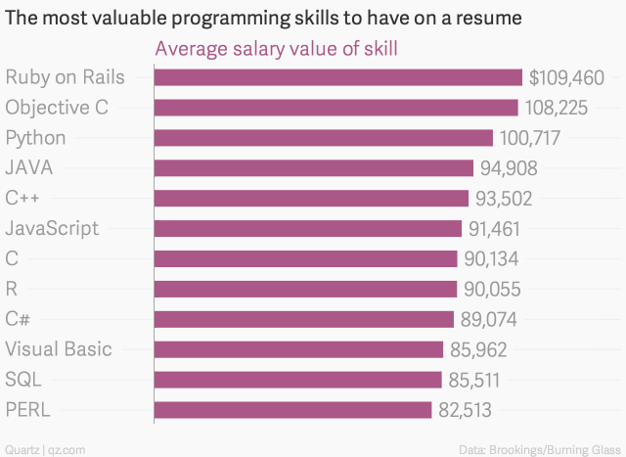
http://qz.com/298635/these-programming-languages-will-earn-you-the-most-money/

Slide 6
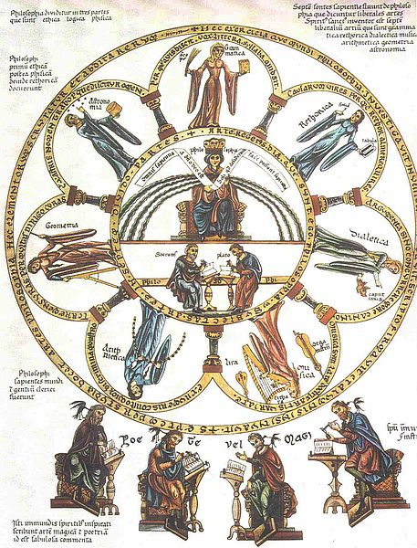
The liberal arts (Latin: artes liberales) are those subjects or skills that in classical antiquity were considered essential for a free person (a citizen) to know in order to take an active part in civic life
http://en.wikipedia.org/wiki/Liberal_arts_education
Notes:
I propose something different... Something that is essential to be a “free” (as in freedom) citizen. Being skilled and informed is essential to being a free citizen.

Slide 7
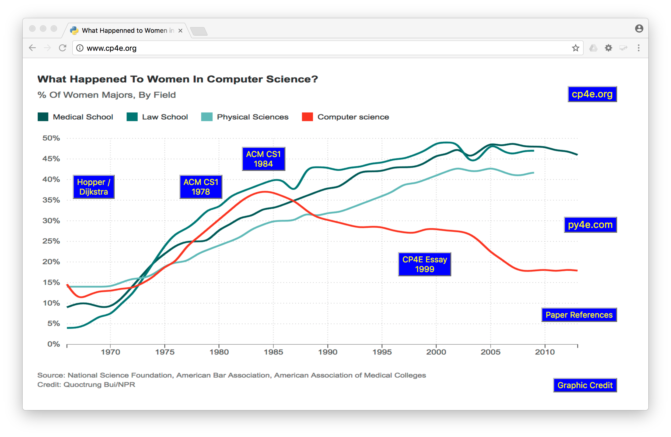

Slide 8
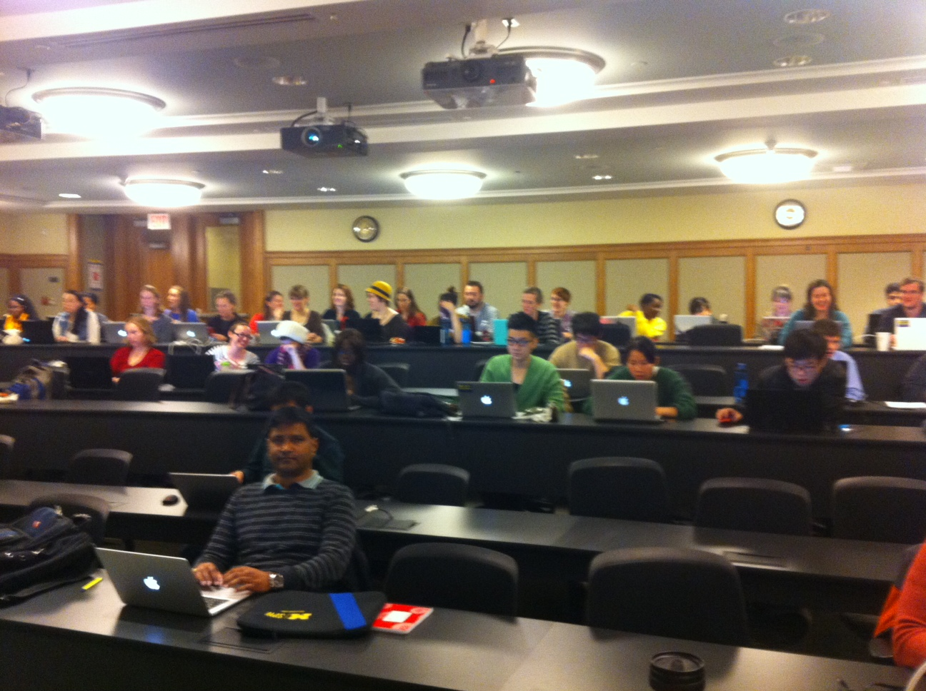
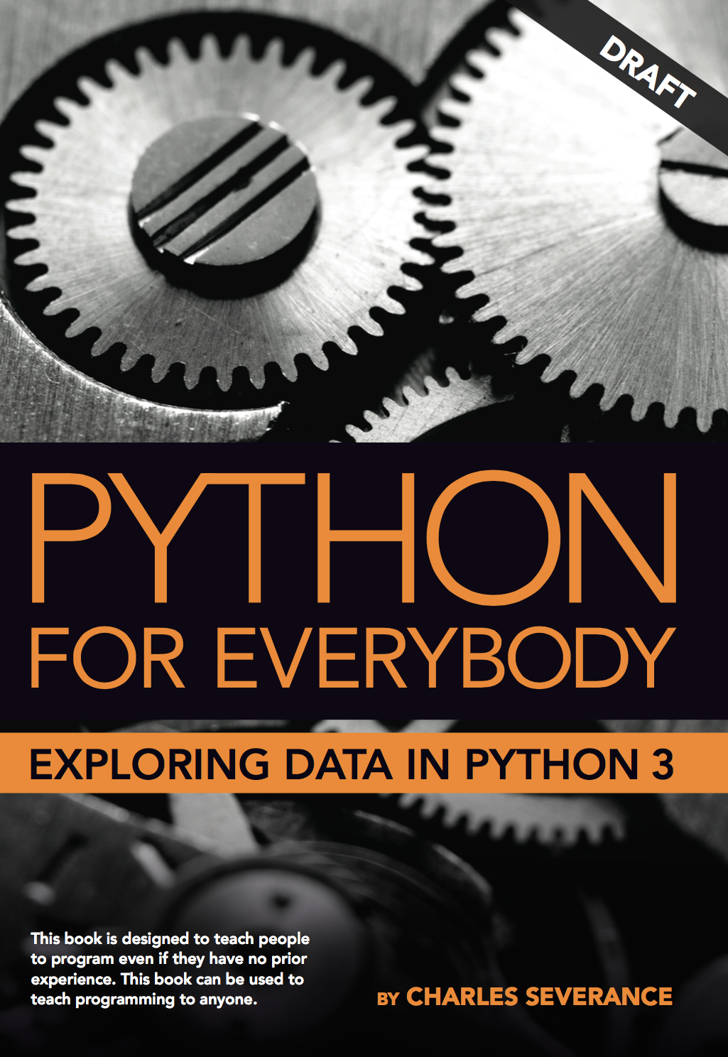
SI502 – Network Computing

Slide 9
Principles of SI502 – Networked Programming
Teach a broad (not deep) set of topics
Focus on Data Analysis – not Math
Avoid "Beautiful Algorithms"
Teach for confidence, delay deep expertise
Goal: Build cusiousity
Goal: Students will take later non-required technology courses

Slide 10
UMSI Technical Curriculum
SI 502 – Networked Computing
Python / Data analysis
Database
SI539 – Web Applications
HTML / CSS
Responsive / Accessible Design
Si664 – Interactive Applications
PHP / SQL
JavaScript

Slide 11

Taking "For Everybody" to Coursera
Internet History, Technology, and Security (15 weeks)
Python for Everybody (5 courses – 30 weeks)
Web Design for Everybody (4 Courses – 25 weeks)
Web Applications for Everybody (5 Courses - 30 weeks)
Coming Fall 2017

Slide 12
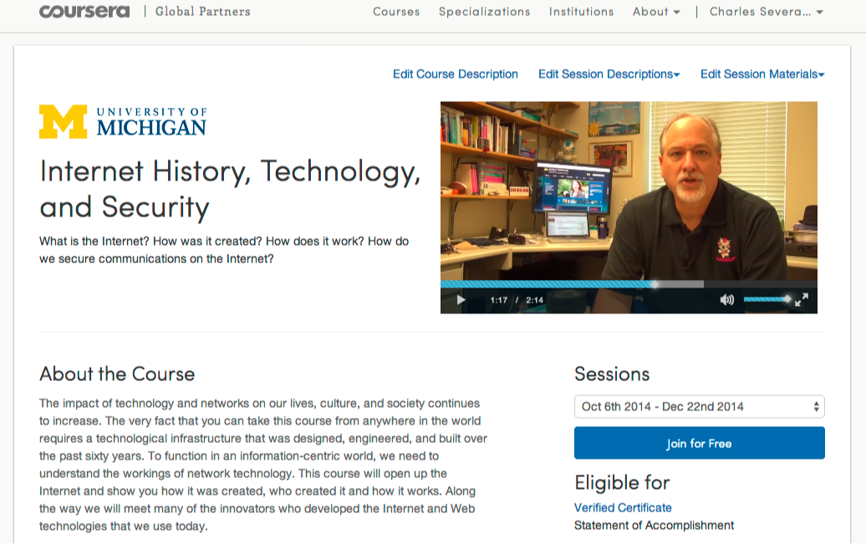

Slide 13
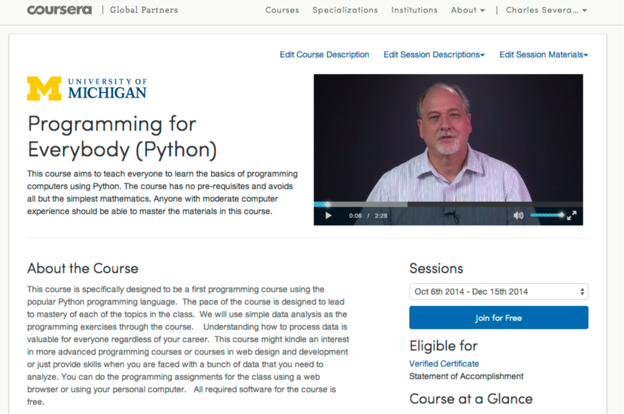

Slide 14
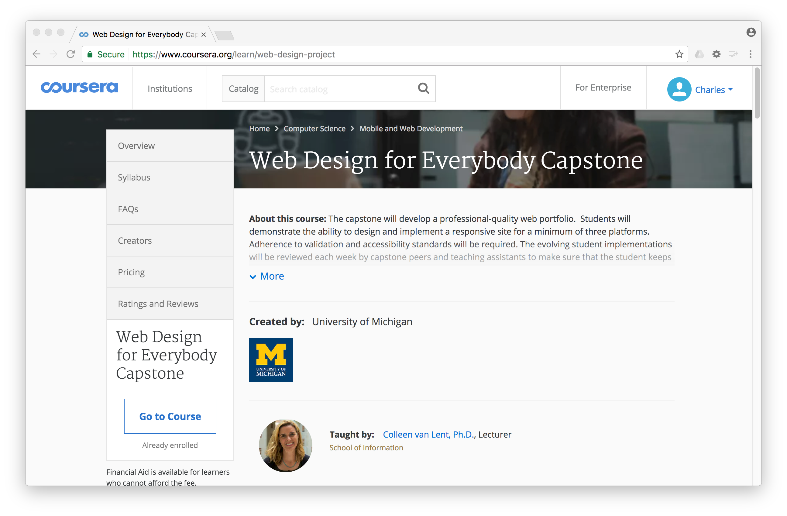

Slide 15
Bachelors of Science in Information

Slide 16
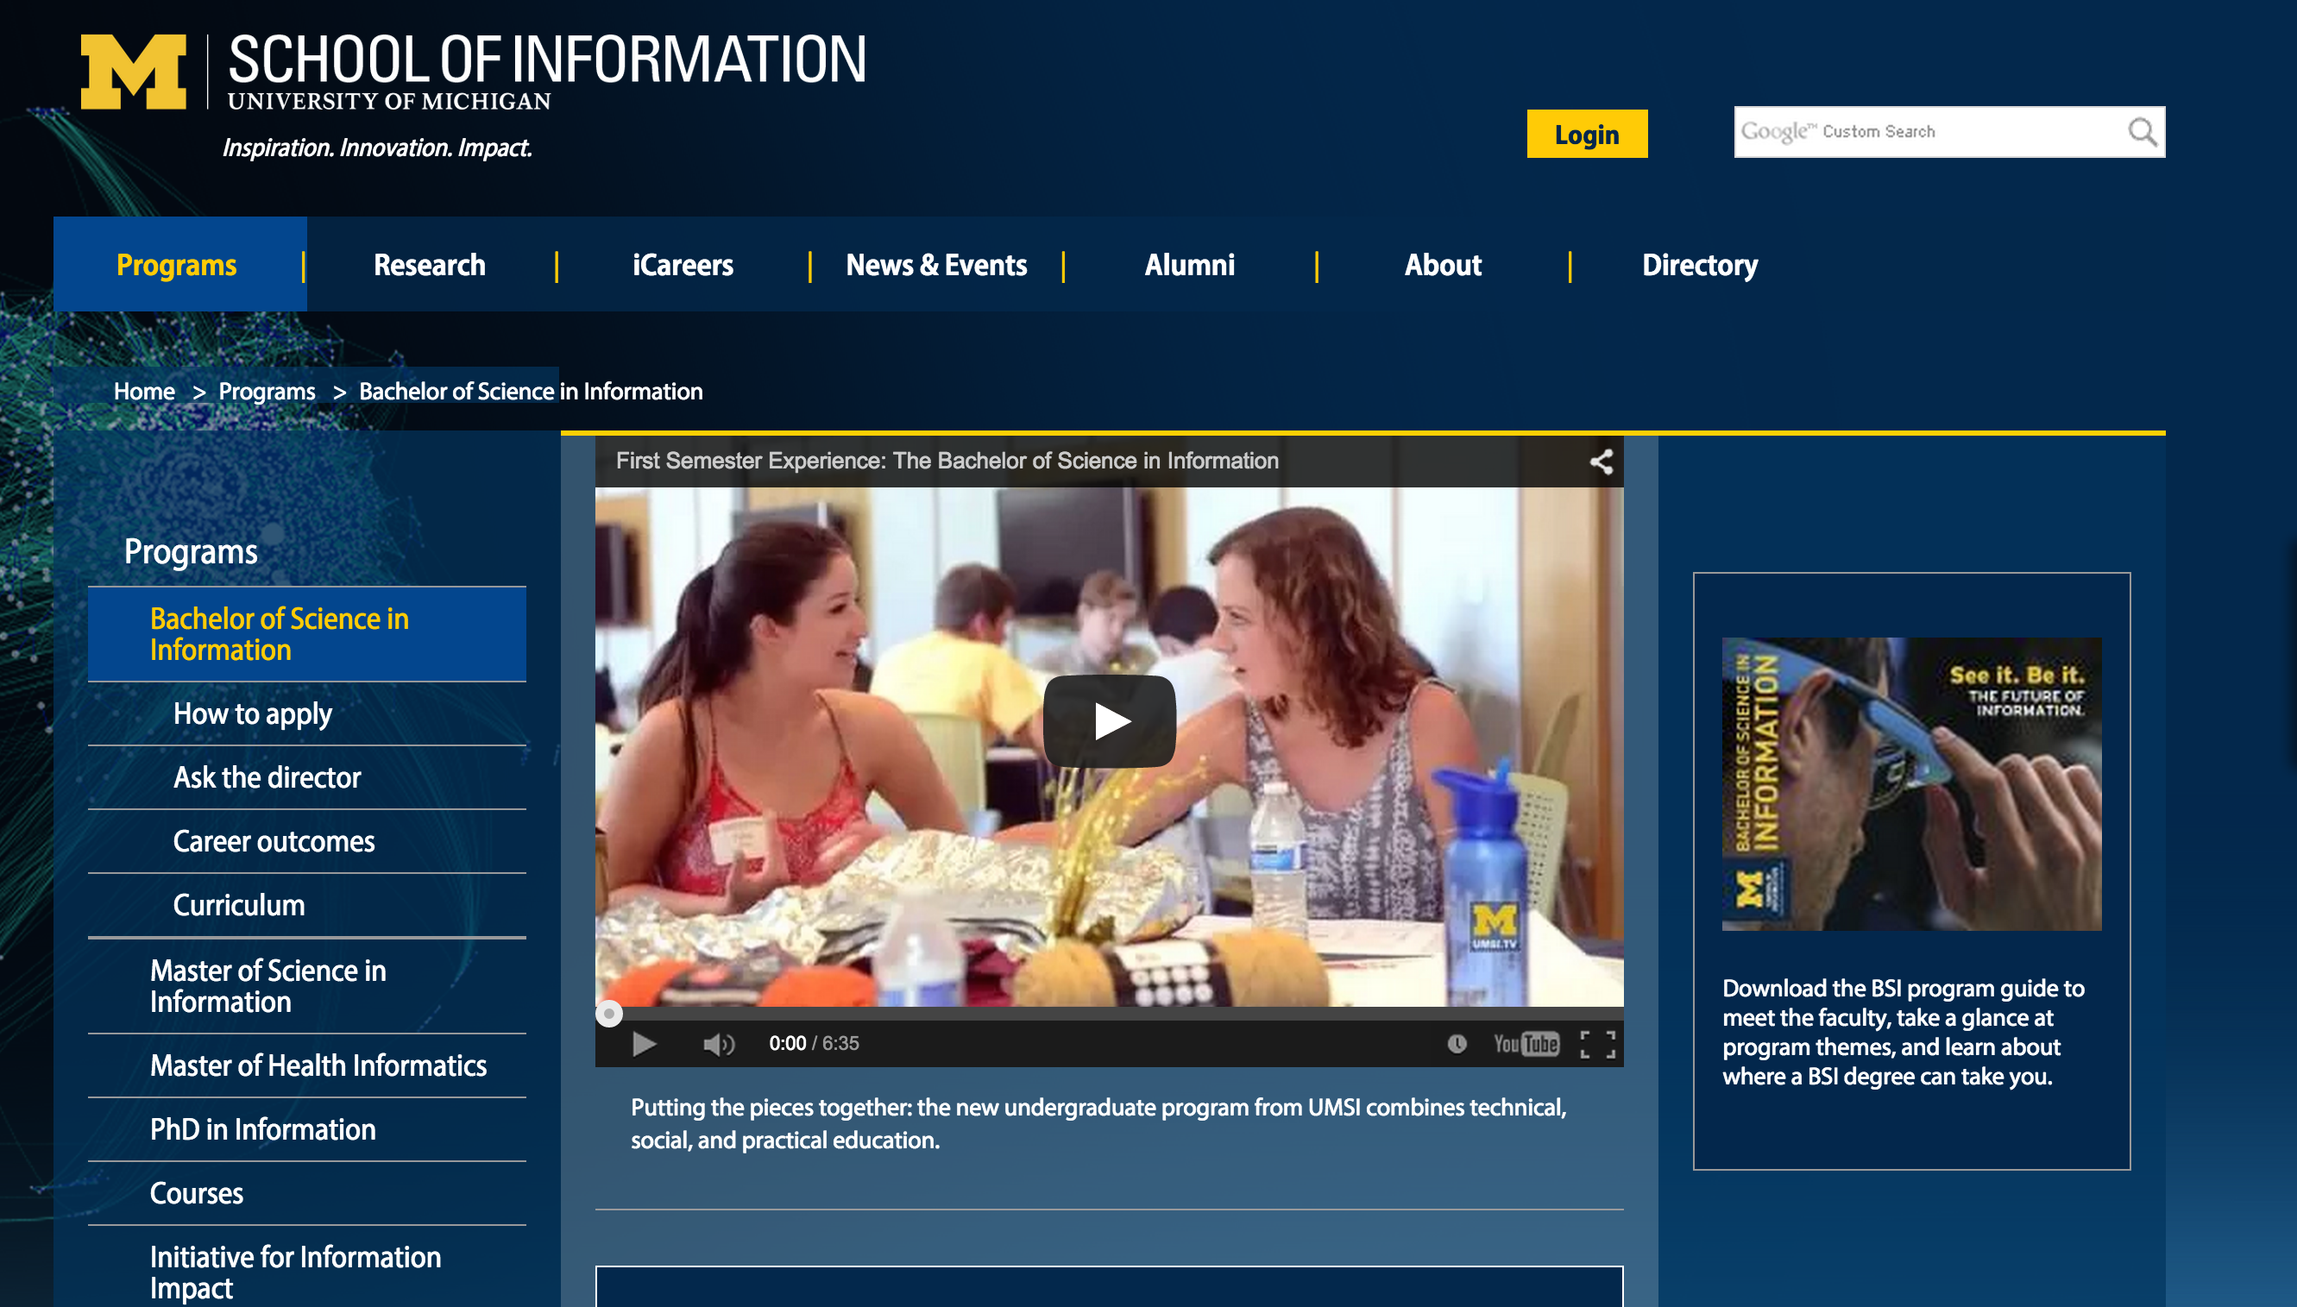
Notes:
Evaluation, Design and Implementing Technology systems BSI, Python, R, JavaScript, Java, PHP, SQL, Swift, ObjectiveC. Statistics, Visualization, Economics, Game Theory, Motivation, Network Analysis.

Slide 17
Notes:
2015 – 57% women

Slide 18
Imagining a High School Curriculum…

